Slide 1
Canada
Canada

Slide 2
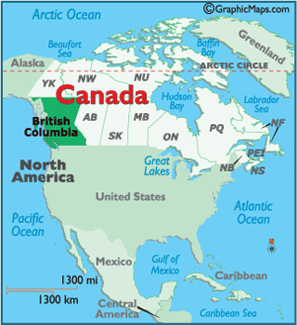
Canada is a country located in North America, stretching from the Atlantic Ocean in the east to the Pacific Ocean in the west and the Arctic Ocean in the north. It borders the United States in the south and northwest

Slide 3
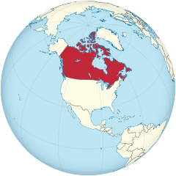
Canada is the second largest country in the world. The capital of Canada is Ottawa - the fourth largest Canadian city. In Canada, as many as two languages ​​are recognized as official - French and English. Canada became independent from the influence of Great Britain in 1982.

Slide 4
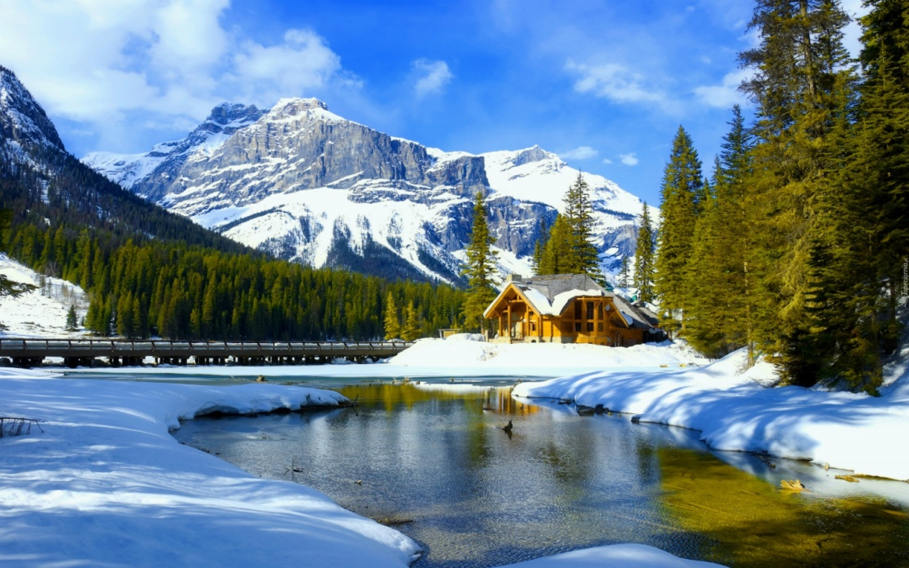
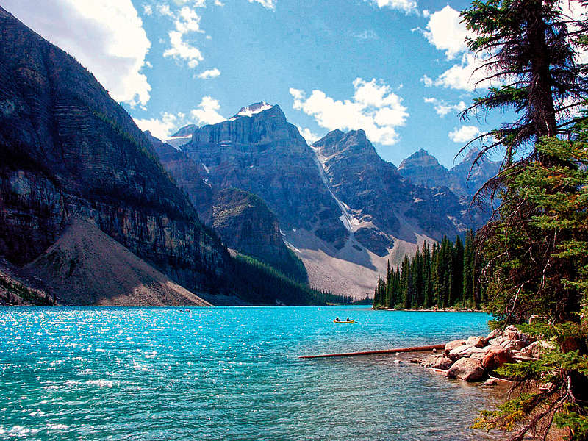
In winter, the temperature there reaches -50 degrees Celsius. In summer, it reaches 19 degrees.

Slide 5
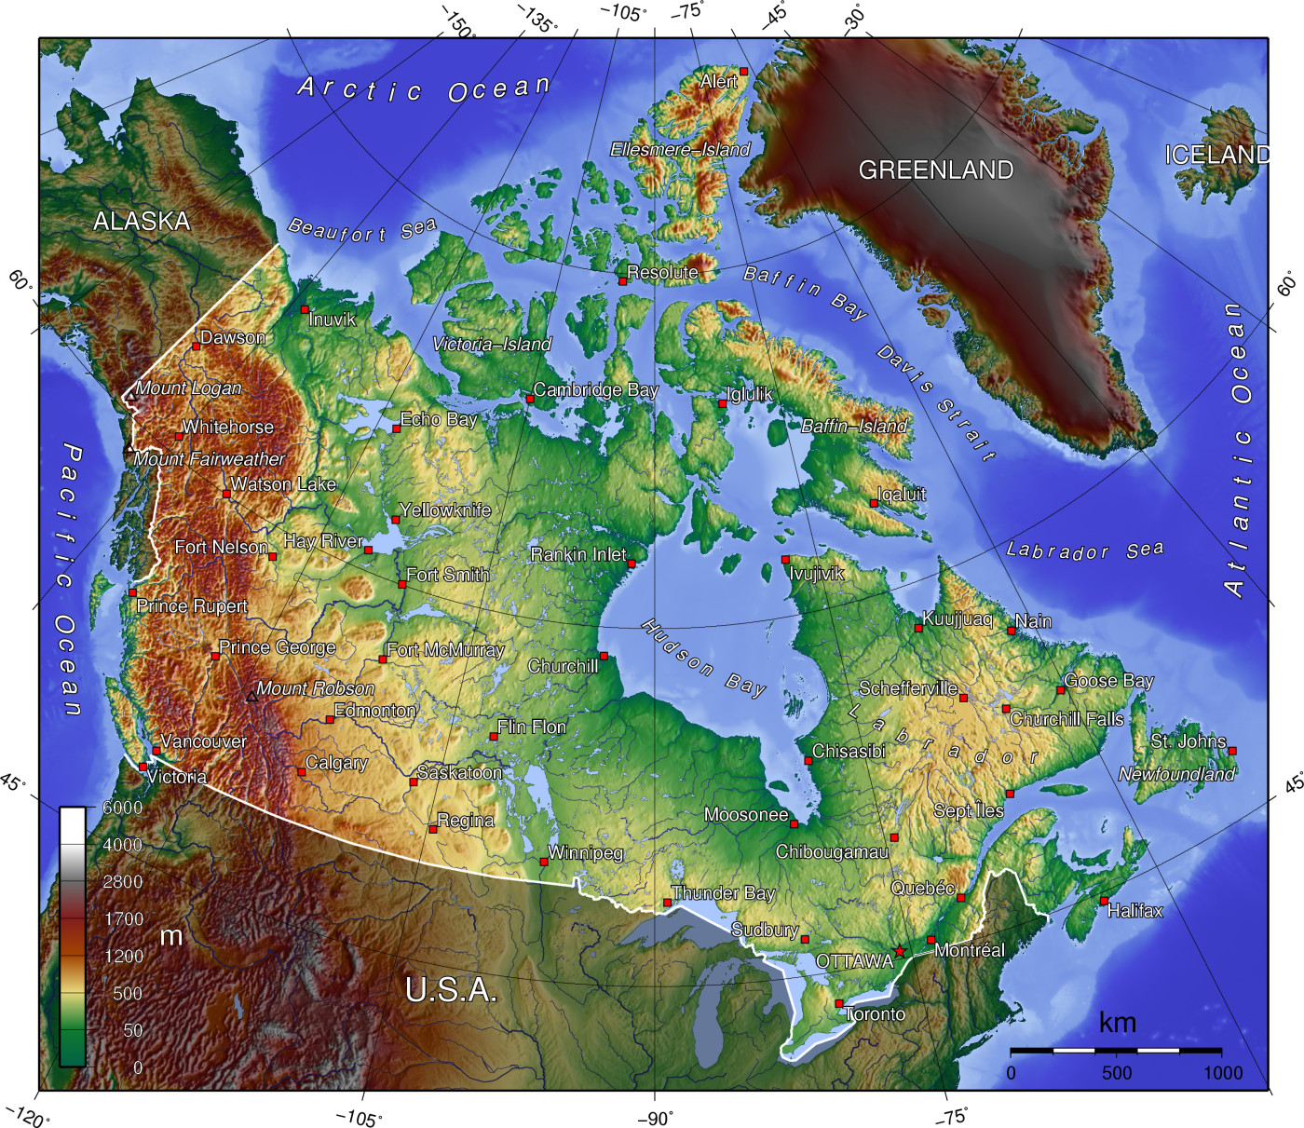
About of Canada's territory is made up of highlands and mountains. To the west, along the coast of the Pacific Ocean are the Cordillera Mountains, which include Canada's highest peak, Logan-5951m above sea level. In the east, the vast territory of the state covers the mountain range of Baffin Island

Slide 6
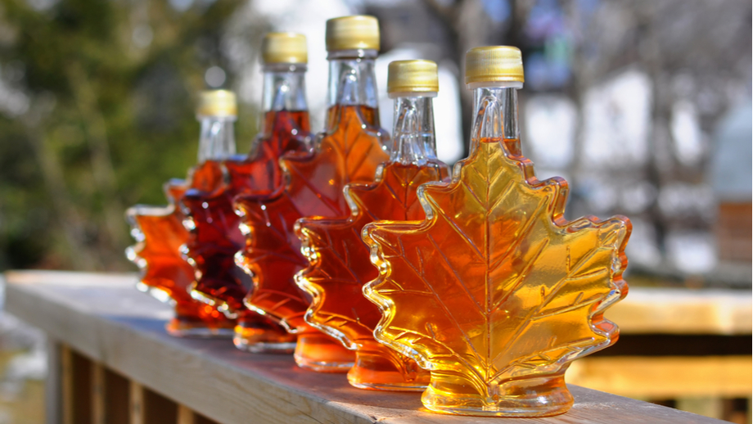
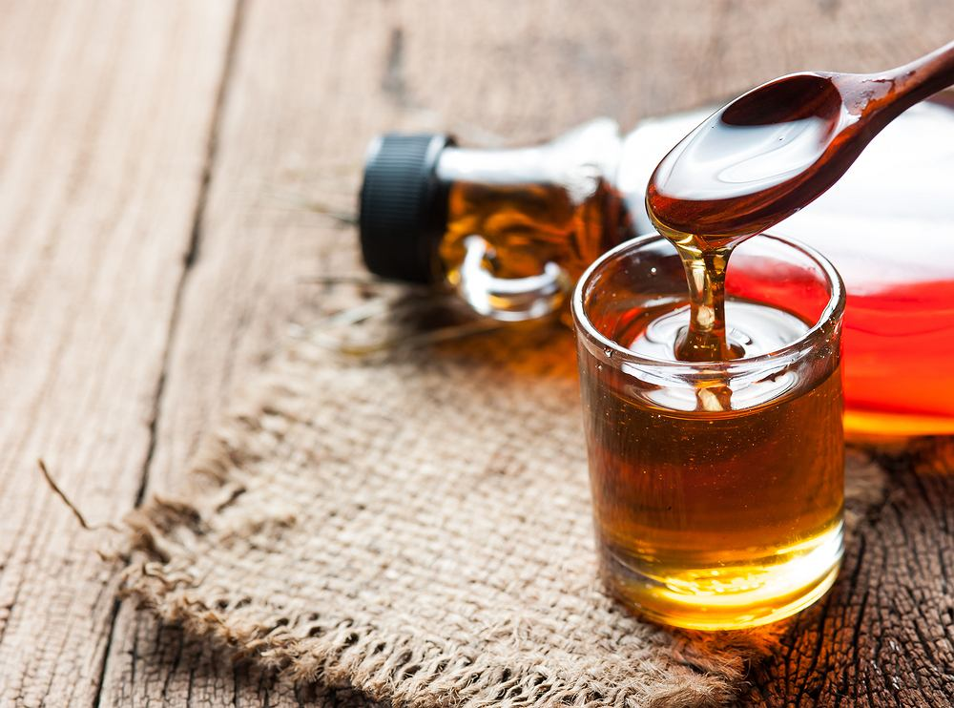
Globally, Canada produces 71% pure maple syrup, 91% of which is produced in Quebec.

