Slide 1
QUIZ

Slide 2
LET’S START
GOOD LUCK !

Slide 3
1. WHAT IS IT ?

Slide 4
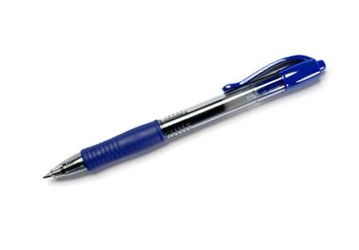
IT’S A PEN.
GOOD JOB !

Slide 5
WHAT DO YOU HEAR ?

Slide 6
1. DUCK
2. ELEPHANT
3. SHEEP
GREAT!

Slide 7
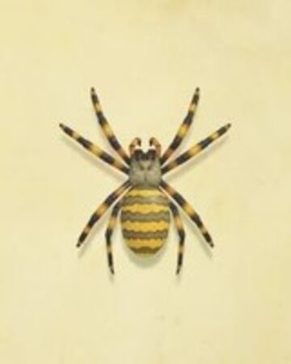
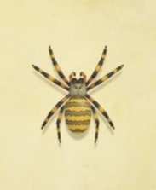
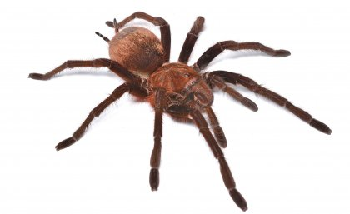
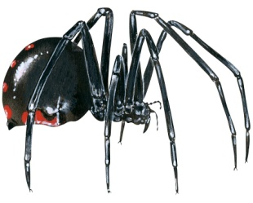
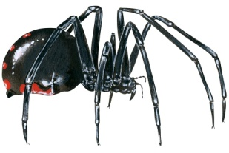
HOW MANY SPIDERS CAN YOU SEE ?

Slide 8
TWENTY – ONE
[ 21]
WELL DONE!

Slide 9
LISTEN AND TRANSLATE INTO POLISH

Slide 10
LOOK AT THE FLAG AND NAME THE COUNTRY

Slide 11
THE UK

Slide 13
SPAIN

Slide 15
ITALY
VERY GOOD!

Slide 16
WELL DONE!

