Slide 1
United States - USA
Author: Maja Orłowska

Slide 2
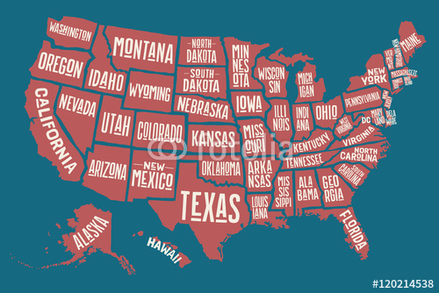
Basic information about the USA
The population as of 2019 was 328.2 million.
The capital of the states is Washington, and the president is Donald Tramp.
The USA consists of 48 states and the state of Alaska.
The currency of the states is dollar.
The states are 4th largest in the world.

Slide 3
History of North America
The history of the United States as a state began at the end of the 18th century, as the resistance of the immigrants of the 13th colonies to English rule grew.
From the 16th century (and especially in the 17th and 18th centuries), there was a period of increased colonization and development of settlement, especially English, in North America.
In 1776, with the adoption of the Declaration of Independence, a new state was created: the United States of America.
The civil war in 1861–1865 was the result of territorial development and the formation of a political and economic system, different in the north and south of the country.

Slide 4
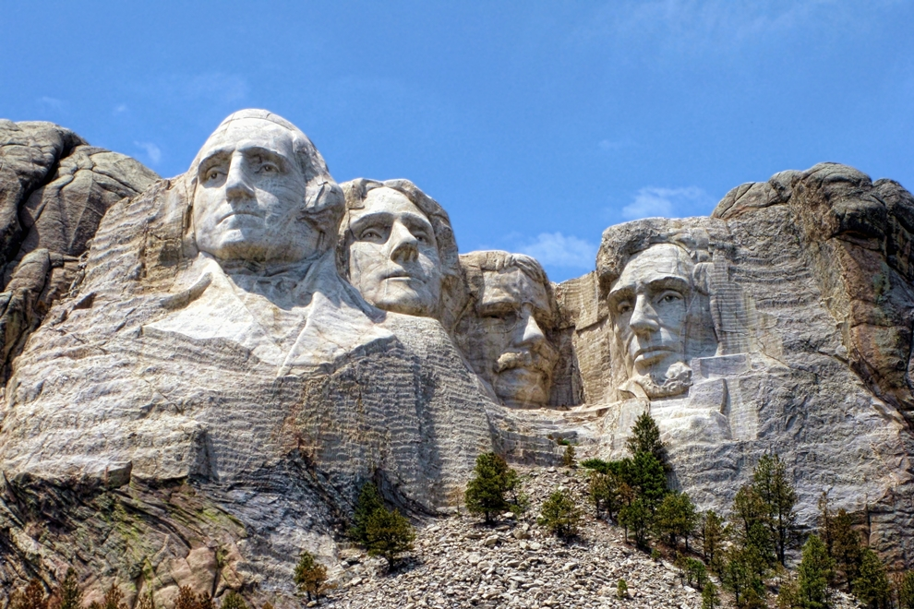
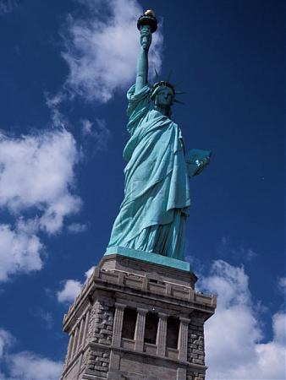
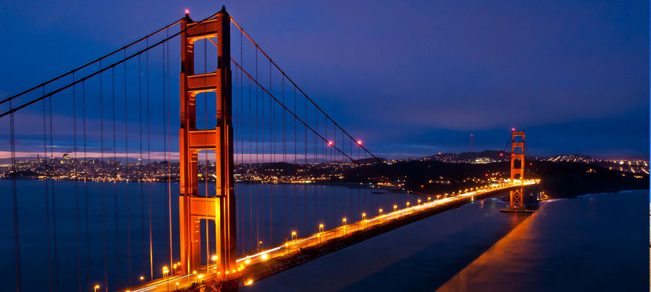
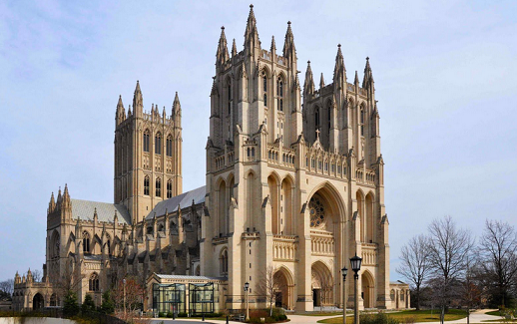
Places in the USA
Statue of Liberty,
Mount Rushmore,
Golden Gate Bridge,
National cathedral in Washington,
And many others.

Slide 5
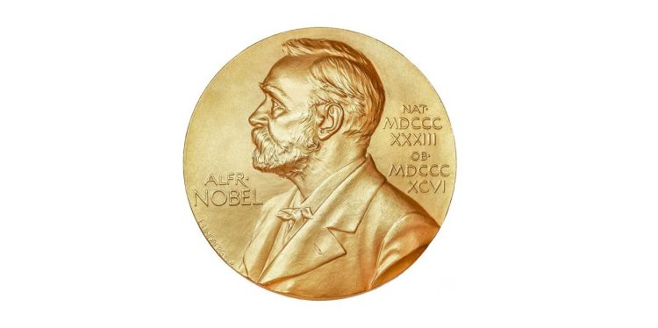
American Nobel Prize winners
Jane Addams.
Peter Agre.
George A. Akerlof.
Christian Anfinsen.
Kenneth Arrow.
Robert Aumann.
Richard Axel.
Julius Axelrod.

Slide 6
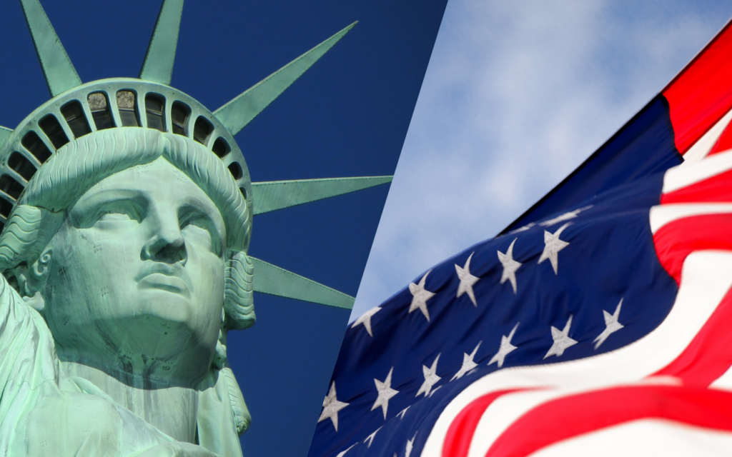
Thank you for watching presentation.

