Slide 1
France
Alicja Wiśniewska

Slide 2
France is located in Western Europe. The capital city of France is Paris. The highest alpine peak, Mount Blanc, is located there.

Slide 3
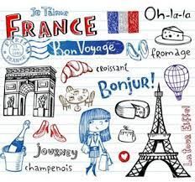
The official language in France is French, it is spoken by the vast majority of the country's inhabitants, but there are many other languages ​​outside of it. French distinguish as many as 75 regional languages

Slide 4
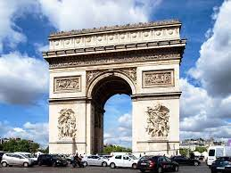
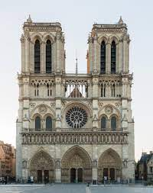
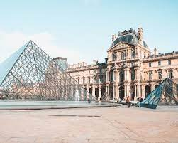
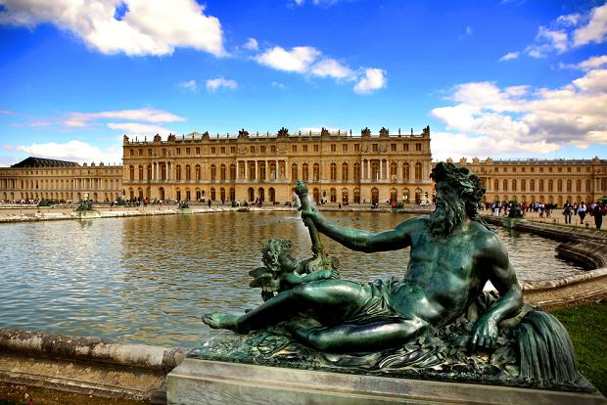
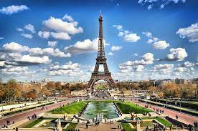
The greatest sights of France are the Eiffle Tower, Louvre, Arc de Triomphe, Palace of Versailles and Notre-Dame Cathedral

Slide 5
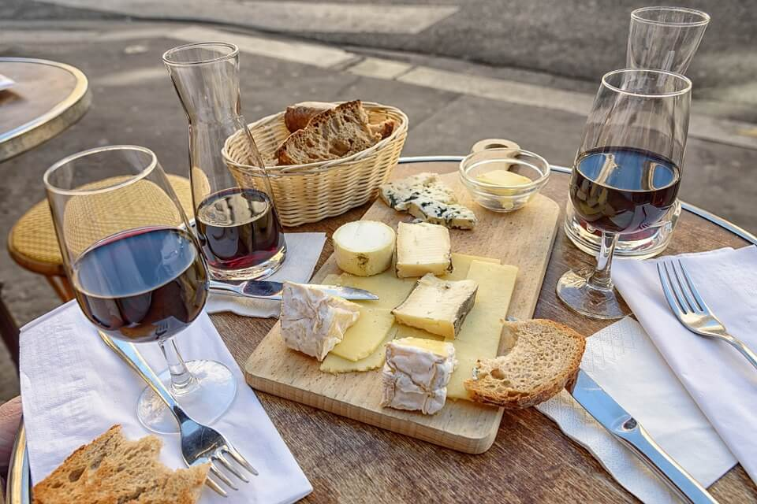
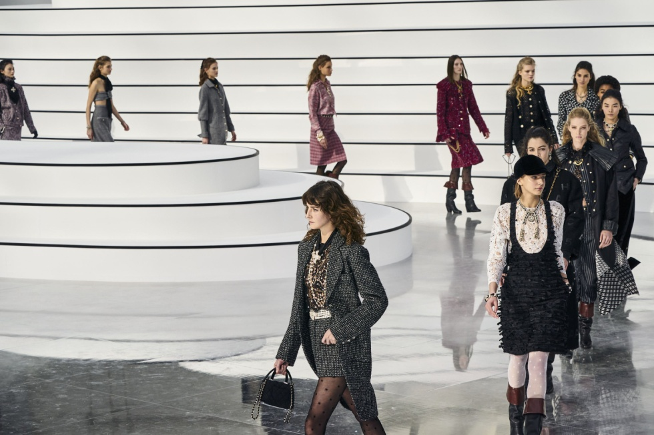
France is associated with exceptional cuisine, good wine and fashion

