Slide 1
DZIEŃ JĘZYKÓW
2021

Slide 2
HISZPANIA
SPAIN

Slide 3
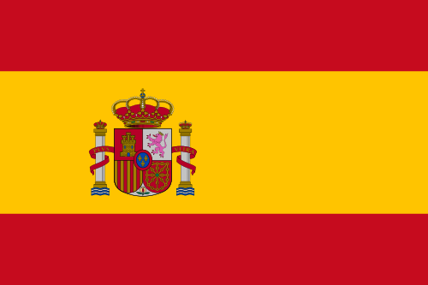
SPAIN
.

Slide 4
BARCELONA
Spain, the third largest European country, takes up most of the Iberian Peninsula, Balearic Islands in the Mediterranean, the Canary Islands in the Atlantic and two small enclaves on the Moroccan coast of Africa. The furthest the southernmost point adjacent through the Straits of Gibraltar from Morocco, as the bridgehead of a bridge between two continents.

Slide 6
COSTA BRAVA

Slide 7
SARAGOSSA

Slide 8
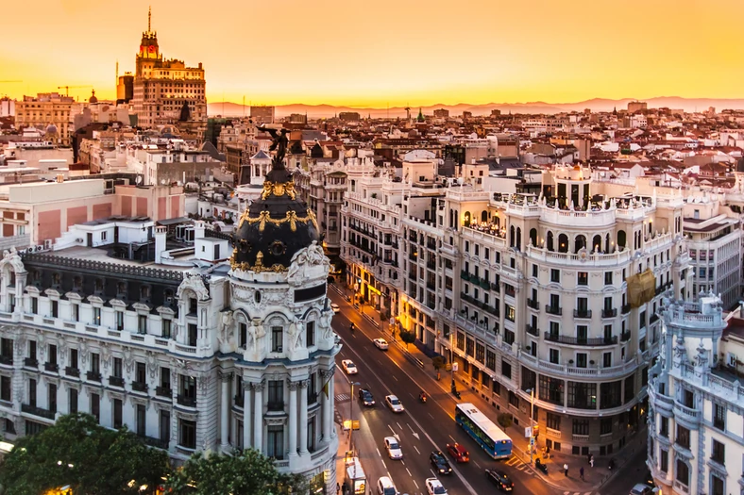
MADRYT

Slide 9
.
MASpain has 39 million inhabitants and visitors each year, more than 57 million visitors. Occupies an area of 504 780 km ². Both capital and largest city is Madrid, which precedes the Barcelona and Valencia. Most of the country occupies a plateau (Iberian Meseta) irrigated by rivers: the Duero, Tagus and Guadiana. Spain has 17 autonomous regions called autonomous communities, which cover 50 provinces.DRYT

Slide 10
.
Popular image of Spain as a country of flamenco, korridy, tapas bars and solemn Easter processions in the slightest does not reflect the diversity of this land. There are four official languages, two great cities of almost equal importance, and the landscape more varied than in any other European country. These remarkable contrasts make Spain a fascinating destination.

Slide 11
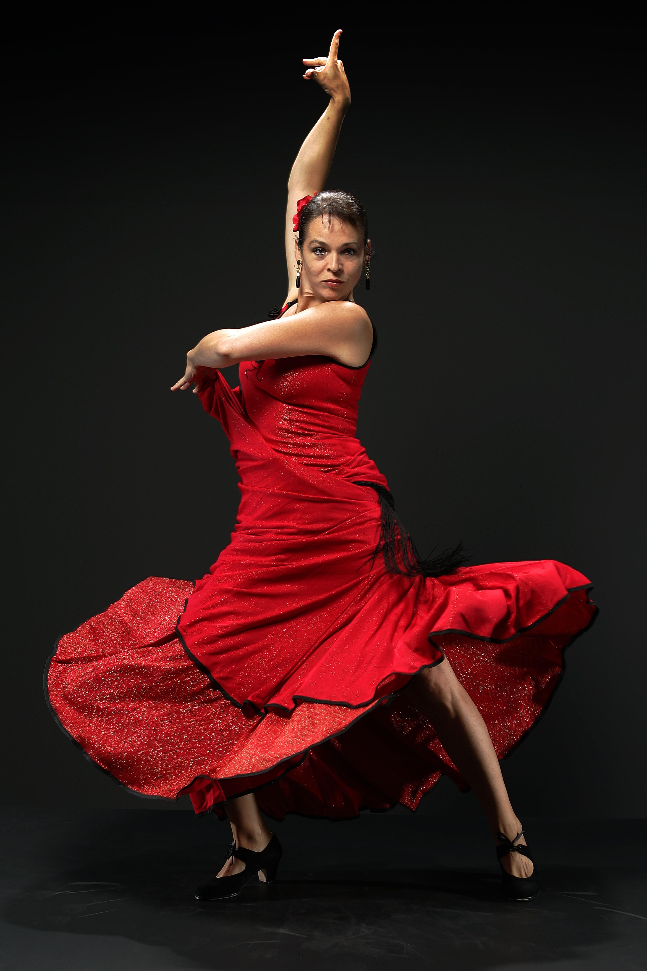
.
.

Slide 12
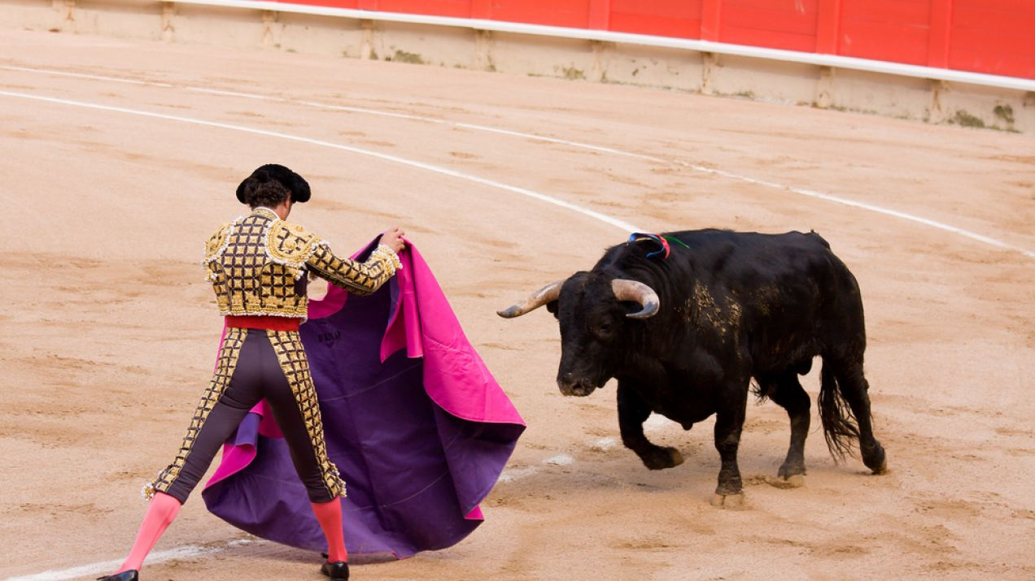
.
.

Slide 13
.
Spain, the Pyrenees in the north is separated from the rest of Europe, dating back almost to the south of Africa. Has a long Atlantic and Mediterranean coasts, and two archipelagos - the Balearic and Canary Islands. Very different here are both the climate and landscape, which varies from snow-capped Pyrenees mountains, through green meadows, Galicia and Valencia orange groves until the Almeria desert.

Slide 14
